Slide 1
OpenGL and WebGL Drawing Functions
CSCI 440
Day Five

Slide 2
OpenGL History
1991 - SGI Inc
current - Khronos consortium
2004 - OpenGL 2.0 replaced 1.5
added the GLSL shader language
2008 - OpenGL 3.0 replaced 2.1
removed glBegin and glEnd
deprecated many vertex and fragment functions
basis of WebGL 2.0
2014 - OpenGL 4.5
direct support of many graphics cards

Slide 3
State Machine
OpenGL, and hence WebGL, is a State Machine
Example:
We do not draw a "red triangle"
we set the drawing color state to red, then draw a triangle
anything drawn after that will also be red until we change the drawing color state
Some functions set states, other functions query the current state

Slide 4
OpenGL v. JavaScript
Types
JavaScript uses dynamic typing
OpenGL is very picky about data types
Object Oriented
neither WebGL nor OpenGL is OO

Slide 5
OpenGL v WebGL
 | OpenGL | WebGL
Text | ✓
Points | ✓ | ✓
Varying Point Types | ✓
Lines | ✓ | ✓
Line Styles | ✓
Polygons | ✓
Unfilled Polygons | ✓
Filled Polygons | ✓
Triangles | ✓ | ✓
Unfilled Triangle | ✓

Slide 6
WebGL Drawing Types
gl.POINTS
gl.LINES
gl.LINE_STRIP
gl.LINE_LOOP
gl.TRIANGLES
gl.TRIANGLE_STRIP
gl.TRIANGLE_FAN
gl.drawArrays ( gl.TRIANGLES, 0, 3 );

Slide 7
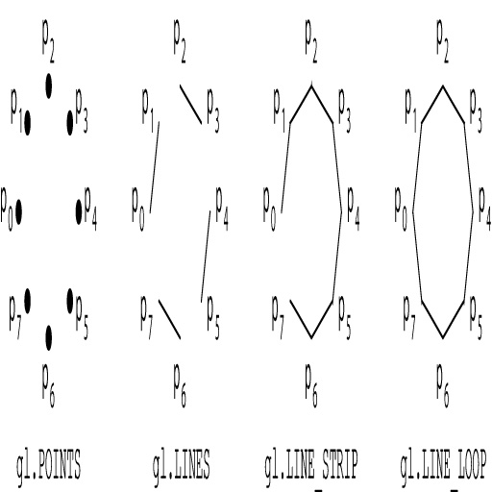
Line Types
Angel figure 2.7

Slide 8
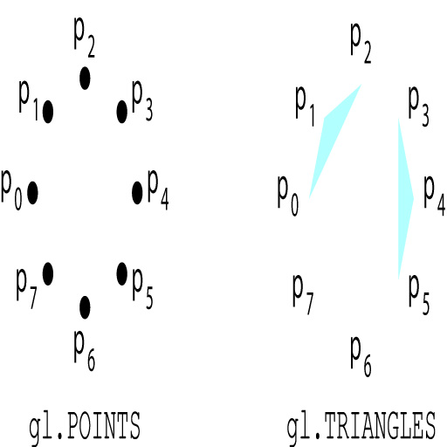
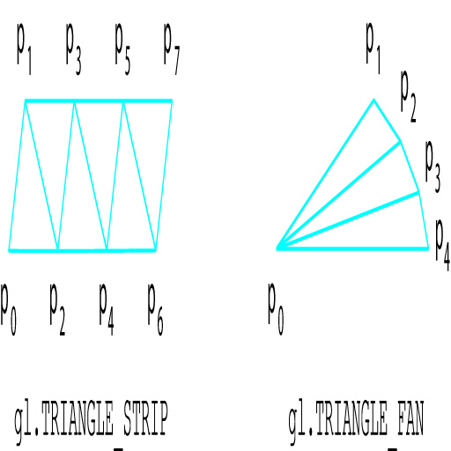
Triangle Types
Angel figures 2.13 & 14

Slide 9
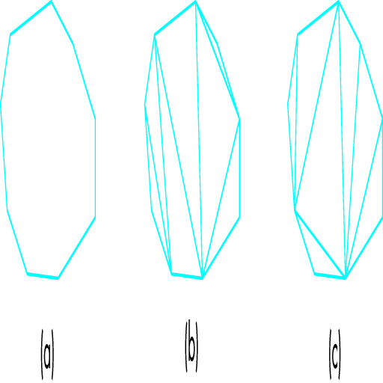
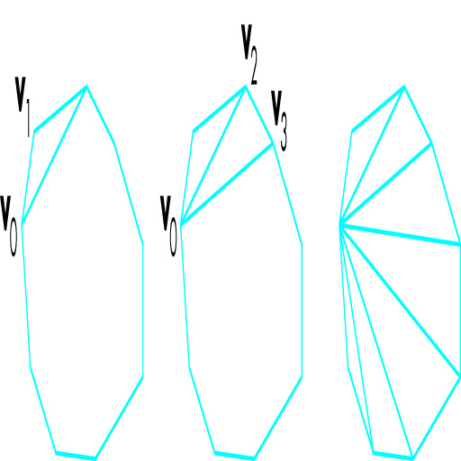
Making Polygons out of Triangles
Angel figures 2.17 & 18

Slide 10
Line and Triangle Attributes
There are very few.
line width does not always work
triangle strips are always filled
etc.
Textures can be applied to produce fill effects and line types.

Slide 11
Point Attributes
In the JavaScript:
gl.enable(gl.VERTEX_PROGRAM_POINT_SIZE);
gl.enable(gl.POINT_SMOOTH); // rounded
In the Vertex Shader:
uniform float pointSize;
void main(void)
{
gl_PointSize = pointSize;

Slide 12
Color
The real world uses Subtractive Color
bricks appear red because the surface is absorbing all colors except red
the street appears black because it is absorbing all colors
Primary Colors = Red Blue Yellow
Computers use Additive Color
"no color" equals black
combining all colors makes white
Primary Colors = Red Green Blue

Slide 13
How can I make these filled shapes?

Slide 14
How can I make these shapes?

Slide 15
Next Classes
Input Principles
Input Code
Matrix Math

